Slide 1
CSE 3400/CSE 5850 - Introduction to Computer & Network Security / Introduction to Cybersecurity Lecture 10 Public Key Cryptography– Part I
Ghada Almashaqbeh
UConn
*Adapted from the textbook slides

Slide 2
Outline
Introduction to public key cryptography and motivation.
Number theory review.
The discrete log assumption.
The Diffie-Hellman key exchange protocol.
2

Slide 3
Intro to Public Key Cryptography
3

Slide 4
Public Key Cryptography
Kerckhoff’s principle: the cryptosystem (algorithm) is public
What we learned until now: symmetric or shared key setting
Only the key is secret (unknown to attacker)
Same key for encryption and decryption ➔ if you can encrypt, you can also decrypt!
Shared keys for MACs and PRFs, etc.
But can we give asymmetric cryptographic capability, e.g., encryption capability without a decryption capability?
Yes, using public key cryptography!

Slide 5
Public Key Cryptosystem (PKC)
Kerckhoff: cryptosystem (algorithm) is public.
[DH76]: can encryption key be public, too??
Decryption key will be different (and private).
Everybody can send me emails, only I can read them.
Key length l
KeyGen KG
Encryption Key e
(public)
(e,d)
Decryption Key d
(private)
e
d
Plaintext
m
Encrypt E
Ciphertext c=E_{e}(m)
Decrypt D
Plaintext m=D_{d}(E_{e}(m))

Slide 6
Is it Only About Encryption?
Also: Digital signatures for integrity and non-repudiation.
Sign with private key s, verify with public key v
(Recall MACs; a shared key cryptosystem for message authentication).
Key length l
KeyGen KG
(s,v)
Private signing key s
Public validation key v
s
v
Sign S
m, σ=S_{s}(m)
Validate V
m if V_{v}(m, σ)=OK
Error otherwise
Message m
Anyone can verify the signature!

Slide 7
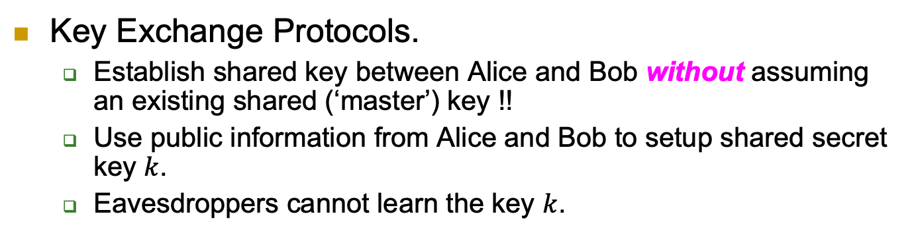
More: Key-Exchange Protocol
Key Exchange Protocols.
Establish shared key between Alice and Bob without assuming an existing shared (‘master’) key !!
Use public information from Alice and Bob to setup shared secret key $k$.
Eavesdroppers cannot learn the key $k$.

Slide 8
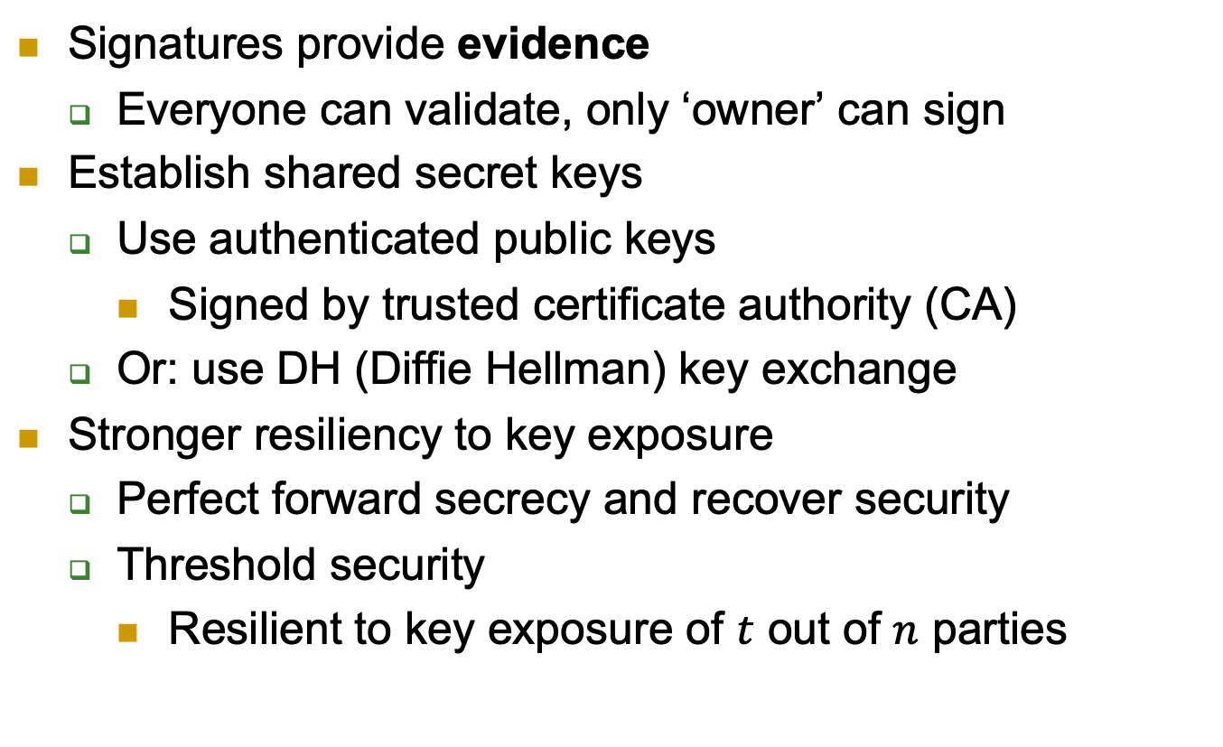
Public keys solve more problems …
Signatures provide evidence
Everyone can validate, only ‘owner’ can sign
Establish shared secret keys
Use authenticated public keys
Signed by trusted certificate authority (CA)
Or: use DH (Diffie Hellman) key exchange
Stronger resiliency to key exposure
Perfect forward secrecy and recover security
Threshold security
Resilient to key exposure of $t$ out of $n$ parties

Slide 9
Public keys are easier…
To distribute:
From directory or from incoming message (still need to be authenticated)
Less keys to distribute (same public key to all)
To maintain:
Can keep in non-secure storage as long as being validated (e.g. using MAC) before using
Less keys: O(|parties|), not O(|parties|²)
So: why not always use public key crypto?

Slide 10
The Price of PKC
Assumptions
Applied PKC algorithms are based on a small number of specific computational assumptions
Mainly: hardness of factoring and discrete-log
Both may fail against quantum computers
Overhead
Computational
Key length
Output length (e.g., ciphertext or signature)

Slide 11
Public key crypto is harder…
Requires related public, private keys
Usually we say a keypair (pk, sk)
Public key does not expose private key
Substantial overhead
Successful cryptanalytic shortcuts → need long keys
Elliptic Curves (EC) may allow shorter key (almost no shortcuts found)
Complex computations, e.g., complex (slow) key generation
Commercial-grade security from [LV02]
[LV02] | Required key size
Year | AES | RSA, DH | ECIES
2010 | 78 | 1369 | 160
2020 | 86 | 1881 | 161
2030 | 93 | 2493 | 176
2040 | 101 | 3214 | 191
For the table:
The year indicates until when confidentiality to be preserved.
AES: A symmetric encryption scheme
RSA and DH: encryption schemes based on factoring and discrete log hardness problems
ECIES: Elliptic Curve Integrated Encryption Scheme

Slide 12
In Sum
Minimize the use of PKC
In particular: as possible, apply PKC only to short inputs
How??
For signatures:
Hash-then-sign
For public-key encryption:
Hybrid encryption

Slide 13
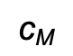
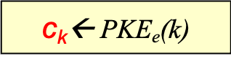
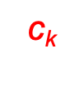
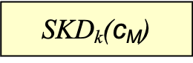
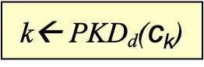
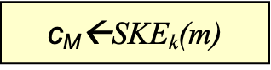
Hybrid Encryption
Challenge: public key cryptosystems are slow
Hybrid encryption:
Use a shared key encryption scheme to encrypt all messages.
But use a public key encryption system to exchange the shared key.
Alice generates k, encrypts it under Bob’s public key and sends the ciphertext c_{k} to Bob.
Bob can decrypt and recover k, and then use k to decrypt c_{M}.
Encryption
Decryption
k ←{0,1}^{n}
$$\text{c}\text{k}$$
$\text{c}\text{k}$← PKE_{e}(k)
k← PKD_{d}($\text{c}\text{k}$)
Plaintext m
$$\text{c}\text{M}$$
m
$\text{c}\text{M}$←SKE_{k}(m)
SKD_{k}($\text{c}\text{M}$)
Notes:
13
10/30/11

Slide 14
Going Forward
First, introduce the mathematical concepts (mainly number theory) that we need for a particular primitive/protocol.
This would involve hardness problems/assumptions.
Then, study the primitive/protocol itself.
Lastly, and as before, show correctness and reason about security.
In general, security will be based on mathematical hardness problems.

Slide 15
Number Theory Review --Modular Arithmetic--
15

Slide 16
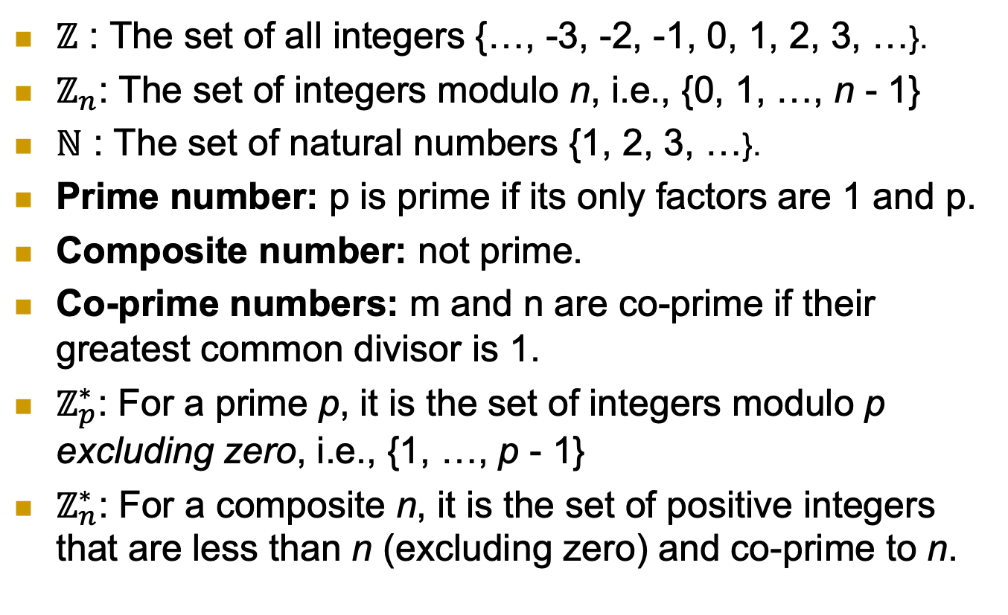
Notation
$ℤ$ : The set of all integers {…, -3, -2, -1, 0, 1, 2, 3, …}.
$ℤ_{n}$: The set of integers modulo n, i.e., {0, 1, …, n - 1}
$ℕ$ : The set of natural numbers {1, 2, 3, …}.
Prime number: p is prime if its only factors are 1 and p.
Composite number: not prime.
Co-prime numbers: m and n are co-prime if their greatest common divisor is 1.
$ℤ_{p}^{∗}$: For a prime p, it is the set of integers modulo p excluding zero, i.e., {1, …, p - 1}
$ℤ_{n}^{∗}$: For a composite n, it is the set of positive integers that are less than n (excluding zero) and co-prime to n.
16

Slide 17
The Modulo Operation
Properties (make it easier to compute complex modular arithmetic expressions):
17

Slide 18
Examples
7 mod 9 = ?
13 mod 8 = ?
0 mod 11 = ?
4 mod 4 = ?
(30 + 66) mod 11 = ?
How about:
18

Slide 19
Multiplicative Inverse
Needed to support division in modular arithmetic.
Division does not always produce integers.
Modular arithmetic requires integers to work with!!
To compute a/c mod m, multiply a by the multiplicative inverse of c.
That is compute a/c mod m = ac⁻¹ mod m.
Where c⁻¹ is the multiplicative inverse such that cc⁻¹ mod m = 1
Not all integers have multiplicative inverses with respect to a specific modulus m.
19

Slide 20
Multiplicative Inverse
Examples:
3/5 mod 4 = 3 . 5⁻¹ mod 4 = ?
3/5 mod 6 = 3 . 5⁻¹ mod 6 = ?
The algorithm used to compute the inverse is called the Extended Euclidean algorithm (out of scope for this course).
20

Slide 21
Modular Exponentiation
Will be encountered a lot; discrete log-based scheme, RSA, etc.
We have seen a property to reduce the base, but how about the exponent?
Its reduction will be with respect to a different modulus than the one in the original operation.
Fermat’s Little Theorem:
21

Slide 22
Modular Exponentiation
Examples; Use Fermat’s Little theorem (if applicable) to solve the following:
13³² mod 31 = ?
19⁹³⁰ mod 4 = ?
19⁶⁰ mod 7 = ?
Can we reduce the exponent for non-prime (composite) modulus?
We can use Euler’s Theorem.
22

Slide 23
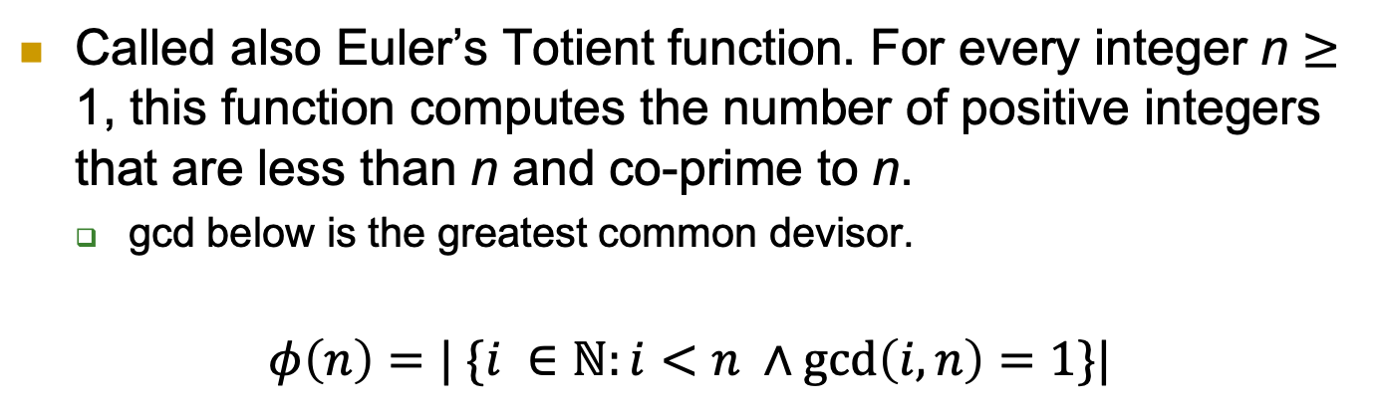
Euler’s Function
Called also Euler’s Totient function. For every integer n $≥$ 1, this function computes the number of positive integers that are less than n and co-prime to n.
gcd below is the greatest common devisor.
$$φ\left(n\right)=| \{i ∈ℕ:i<n ∧\gcd\left(i, n\right)=1\}|$$
Examples:
23

Slide 24
Euler’s Function Properties
24

Slide 25
Euler’s Theorem
Examples:
13³¹ mod 31 = ?
27²⁶ mod 10 = ?
25

Slide 26
Key Exchange
26

Slide 27



The Key Exchange Problem
Aka key agreement
Alice and Bob want to agree on secret (key)
Secure against eavesdropper adversary
Assume no prior shared secrets (key)

Slide 28
Defining a Key Exchange Protocol
*KG: Key Generate, KC: Key Compute, a and b are secret, while P_{A} and P_{B} are public
Must satisfy:
Correctness; both parties compute the same shared key,
and key indistinguishability; the key that the two parties establish is indistinguishable from random.

Slide 29
Discrete Log (DL) Assumption
29

Slide 30
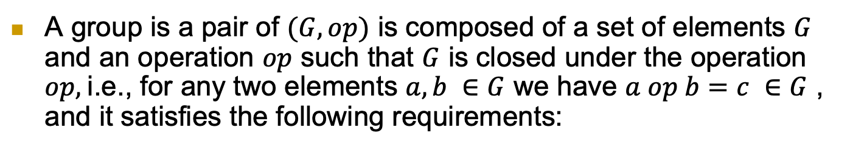
--Group Theory Review--
A group is a pair of $(G, op)$ is composed of a set of elements $G$ and an operation $op$ such that $G$ is closed under the operation $op,$i.e., for any two elements $a, b ∈G$ we have $a op b=c ∈G$ , and it satisfies the following requirements:
Notes:
$ℤ_{p}^{∗}$ contains element of$ℤ_{p}^{}$ which are relatively-prime to p, i.e., gcd(a,p)=1; for prime p this holds for entire $ℤ_{p}^{}, i.e.ℤ_{p}^{∗}=ℤ_{p}^{}$
Evidences of intentional manipulation of crypto choices in few cases, e.g., Juniper Network ‘16.

Slide 31
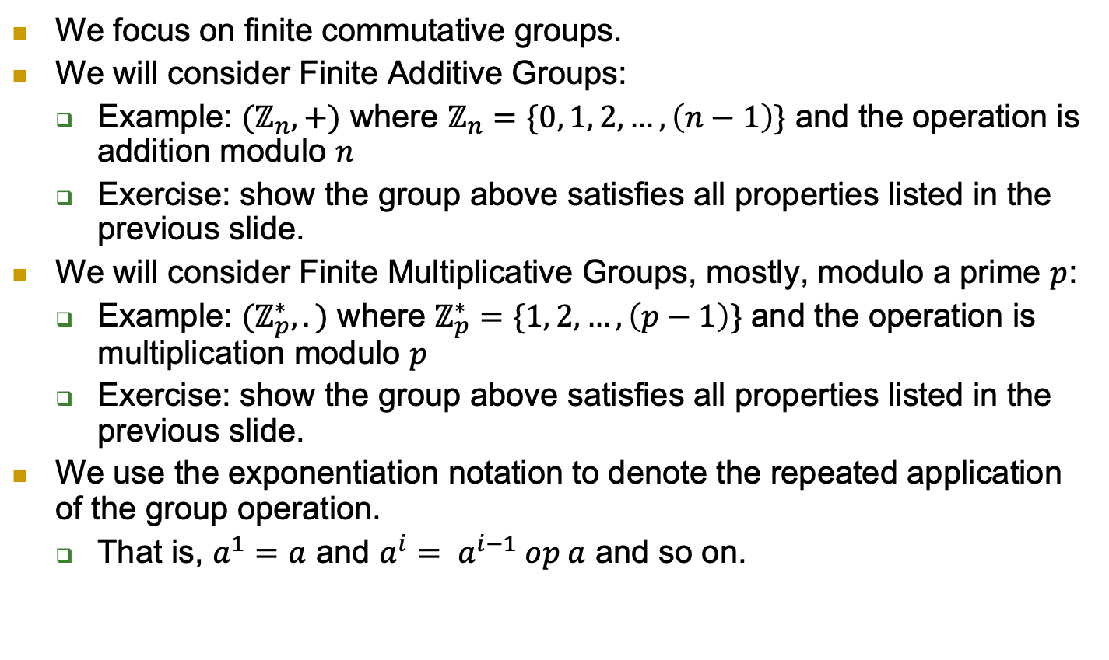
--Group Theory Review--
We focus on finite commutative groups.
We will consider Finite Additive Groups:
Example: $(ℤ_{n}, +)$ where $ℤ_{n}=\{0, 1, 2, …, \left(n−1\right)\}$ and the operation is addition modulo $n$
Exercise: show the group above satisfies all properties listed in the previous slide.
We will consider Finite Multiplicative Groups, mostly, modulo a prime $p$:
Example: $(ℤ_{p}^{∗}, .)$ where $ℤ_{p}^{∗}=\{1, 2, …, \left(p−1\right)\}$ and the operation is multiplication modulo $p$
Exercise: show the group above satisfies all properties listed in the previous slide.
We use the exponentiation notation to denote the repeated application of the group operation.
That is, $a^{1}=a$ and $a^{i}= a^{i−1} op a$ and so on.
Notes:
$ℤ_{p}^{∗}$ contains element of$ℤ_{p}^{}$ which are relatively-prime to p, i.e., gcd(a,p)=1; for prime p this holds for entire $ℤ_{p}^{}, i.e.ℤ_{p}^{∗}=ℤ_{p}^{}$
Evidences of intentional manipulation of crypto choices in few cases, e.g., Juniper Network ‘16.

Slide 32
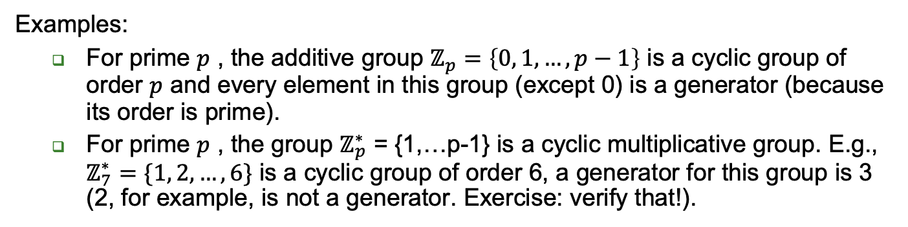
--Cyclic Groups--
Examples:
For prime $p$ , the additive group $ℤ_{p}=\left\{0, 1, …, p−1\right\}$ is a cyclic group of order $p$ and every element in this group (except 0) is a generator (because its order is prime).
For prime $p$ , the group $ℤ_{p}^{∗}$ = {1,…p-1} is a cyclic multiplicative group. E.g., $ℤ_{7}^{∗}=\{1, 2, …, 6\}$ is a cyclic group of order 6, a generator for this group is 3 (2, for example, is not a generator. Exercise: verify that!).
Notes:
$ℤ_{p}^{∗}$ contains element of$ℤ_{p}^{}$ which are relatively-prime to p, i.e., gcd(a,p)=1; for prime p this holds for entire $ℤ_{p}^{}, i.e.ℤ_{p}^{∗}=ℤ_{p}^{}$
Evidences of intentional manipulation of crypto choices in few cases, e.g., Juniper Network ‘16.

Slide 33
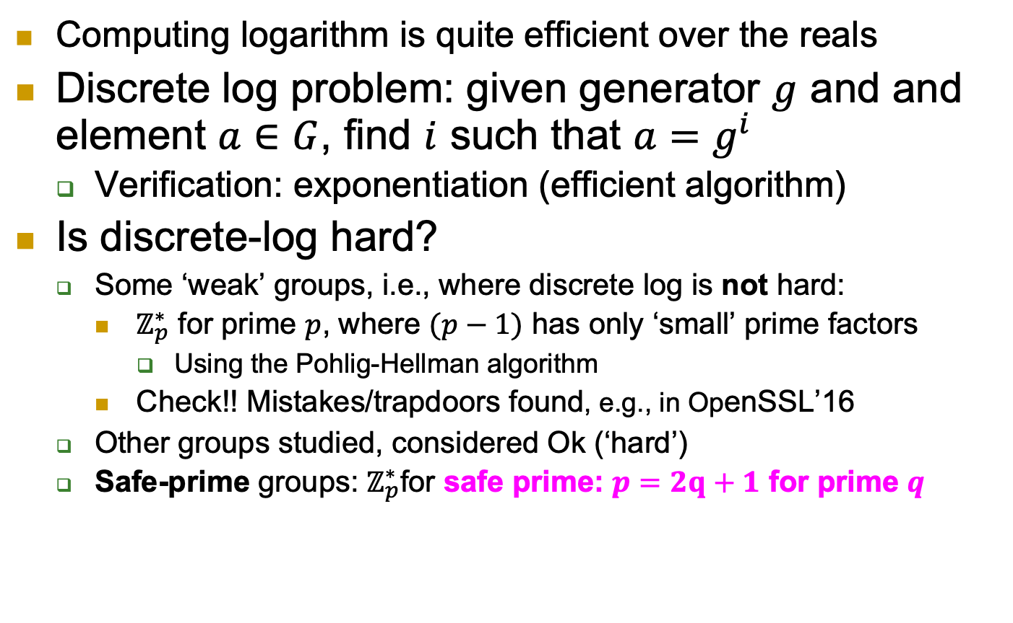
The Discrete Log Problem
Computing logarithm is quite efficient over the reals
Discrete log problem: given generator $g$ and and element $a∈G$, find $i$ such that $a=g^{i}$
Verification: exponentiation (efficient algorithm)
Is discrete-log hard?
Some ‘weak’ groups, i.e., where discrete log is not hard:
$ℤ_{p}^{∗}$ for prime $p$, where $(p−1)$ has only ‘small’ prime factors
Using the Pohlig-Hellman algorithm
Check!! Mistakes/trapdoors found, e.g., in OpenSSL’16
Other groups studied, considered Ok (‘hard’)
Safe-prime groups: $ℤ_{p}^{∗}$for safe prime: $p=2q+1$ for prime $q$
Notes:
$ℤ_{p}^{∗}$ contains element of$ℤ_{p}^{}$ which are relatively-prime to p, i.e., gcd(a,p)=1; for prime p this holds for entire $ℤ_{p}^{}, i.e.ℤ_{p}^{∗}=ℤ_{p}^{}$
Evidences of intentional manipulation of crypto choices in few cases, e.g., Juniper Network ‘16.

Slide 34
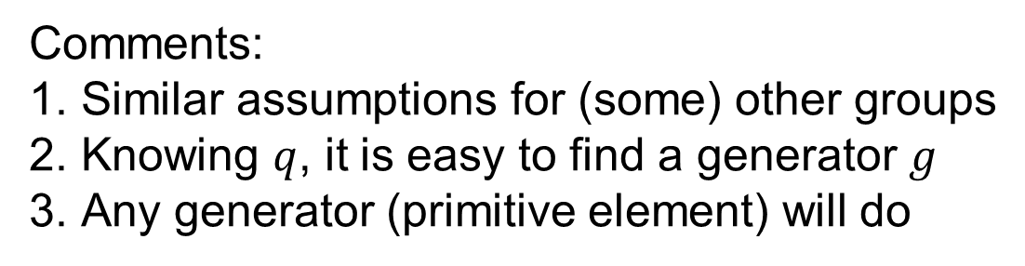
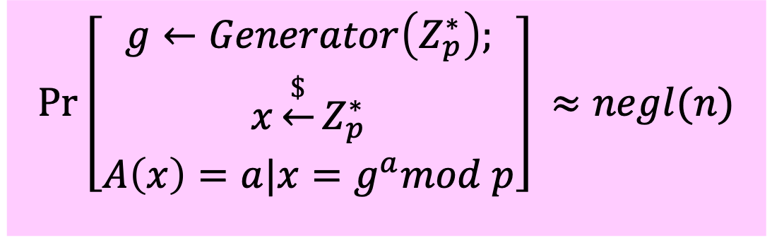
Discrete Log Assumption [for safe prime group]
Given PPT adversary A, and n-bit safe prime p:
$$Pr\left[\begin{matrix}g←Generator\left(Z_{p}^{∗}\right); \\ x\underset{←}{\$}Z_{p}^{∗} \\ A\left(x\right)=a|{x=g}^{a}mod p\end{matrix}\right]⁡≈negl(n)$$
Comments:
Similar assumptions for (some) other groups
Knowing $q$, it is easy to find a generator $g$
Any generator (primitive element) will do

Slide 35
The Diffie-Hellman (DH) Key Exchange Protocol and The Computational/Decisional Diffie-Hellman Assumptions (CDH/DDH)
35

Slide 36
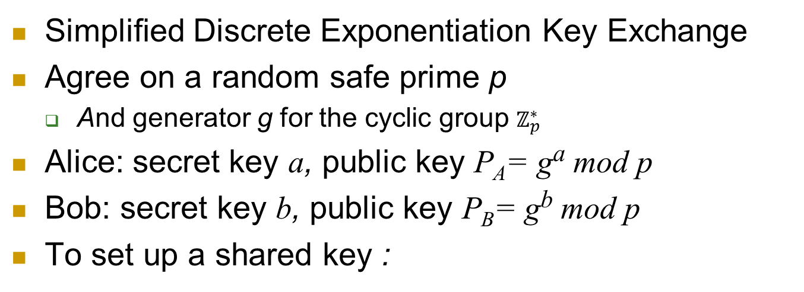
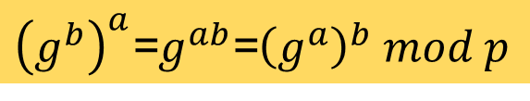
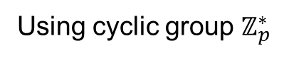
Diffie-Hellman [DH] Key Exchange
Using cyclic group $ℤ_{p}^{∗}$
Simplified Discrete Exponentiation Key Exchange
Agree on a random safe prime p
And generator g for the cyclic group $ℤ_{p}^{∗}$
Alice: secret key a, public key P_{A}= gª mod p
Bob: secret key b, public key P_{B}= g^{b} mod p
To set up a shared key :
Alice
Bob
Select a
P_{A}= gª mod p
Select b
P_{B}= g^{b} mod p
${\left(g^{b}\right)}^{a}$=$g^{ab}$=${\left(g^{a}\right)}^{b} mod p$

Slide 37
Caution: Authenticate Public Keys!
Diffie-Hellman key exchange is only secure using the authentic public keys
Or (equivalently): against eavesdropper
If Bob simply receives Alice’s public key, [DH] is vulnerable to `Man in the Middle` attack

Slide 38
Security of [DH] Key Exchange
Assume authenticated communication
Based on Computational Discrete Log Assumption
But DH requires stronger assumption than Discrete Log:
Maybe from g^{b} mod p and gª mod p, adversary can compute g^{ab} mod p (without knowing/learning a,b or ab)?
P_{A}=gª mod p
Alice
Bob
P_{B}=g^{b} mod p

Slide 39
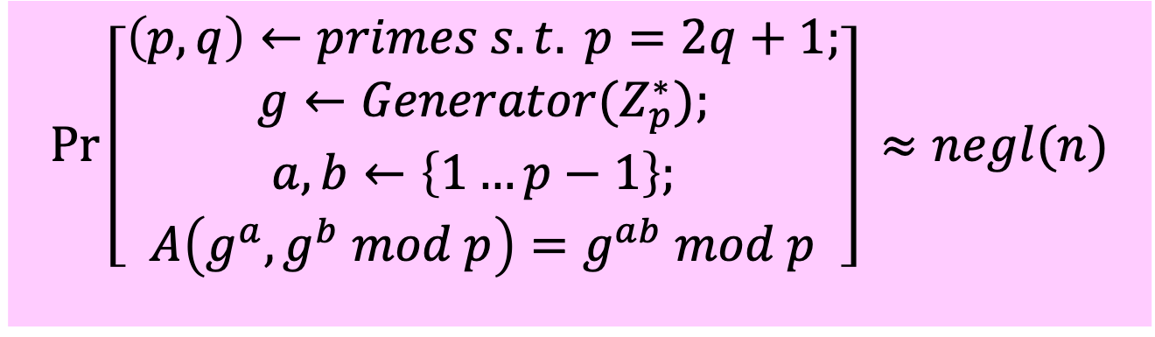
Computational DH (CDH) Assumption [for safe prime group]
Given PPT adversary A:
$$Pr\left[\begin{aligned}\left(p,q\right)←primes s.t. p=2q+1; \\ g←Generator{(Z}_{p}^{∗}); \\ a,b←\left\{1…p−1\right\}; \\ A\left(g^{a},g^{b} mod p\right)=g^{ab} mod p\end{aligned}\right]⁡≈negl(n)$$
Assume CDH holds. Can we use $g^{ab}$as key?
Not necessarily; maybe finding some bits of $g^{ab}$ is easy?

Slide 40
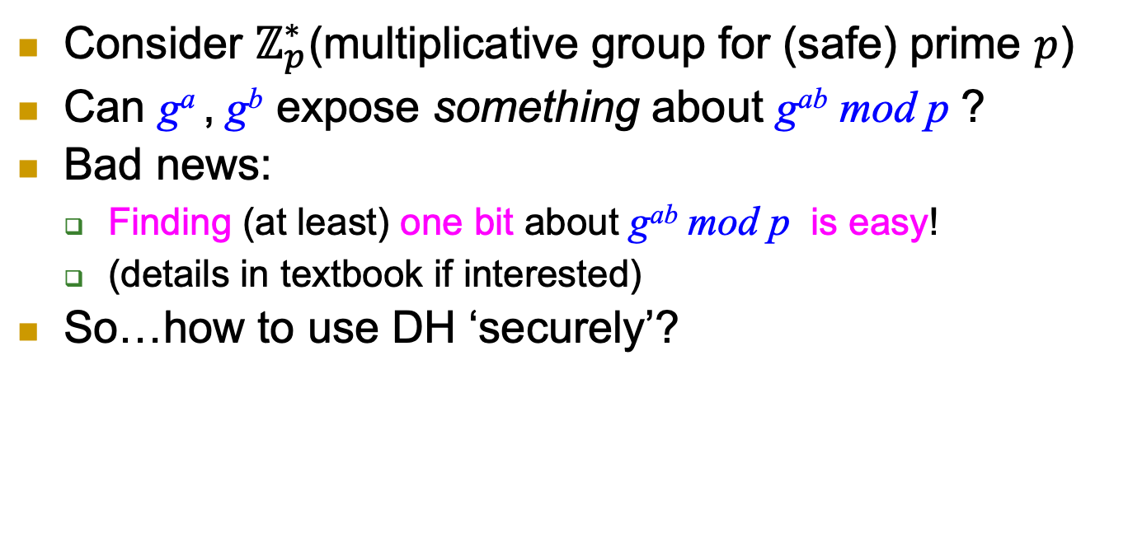
Using DH securely?
Consider $ℤ_{p}^{∗}$(multiplicative group for (safe) prime $p$)
Can gª , g^{b} expose something about g^{ab} mod p ?
Bad news:
Finding (at least) one bit about g^{ab} mod p is easy!
(details in textbook if interested)
So…how to use DH ‘securely’?
Notes:
Exercise: show how to compute Legenre of g^ab !

Slide 41
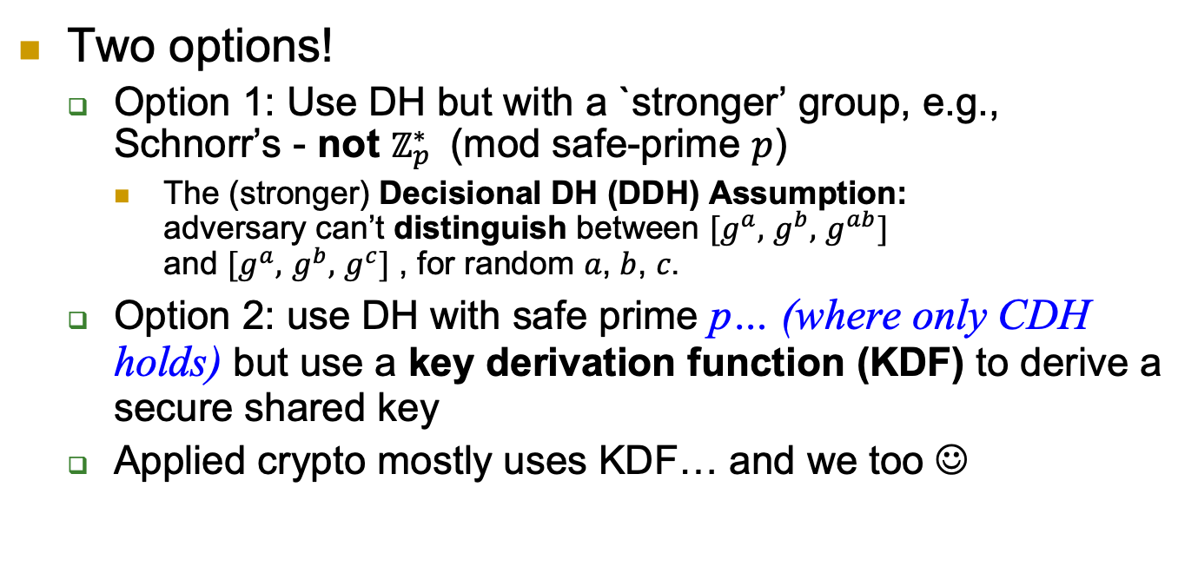
Using DH securely?
Two options!
Option 1: Use DH but with a `stronger’ group, e.g., Schnorr’s - not $ℤ_{p}^{∗}$ (mod safe-prime $p$)
The (stronger) Decisional DH (DDH) Assumption: adversary can’t distinguish between $[g^{a},$ $g^{b},$ $g^{ab}]$ and $[g^{a},$ $g^{b},$ $g^{c}]$ , for random 𝑎, 𝑏, 𝑐.
Option 2: use DH with safe prime p… (where only CDH holds) but use a key derivation function (KDF) to derive a secure shared key
Applied crypto mostly uses KDF… and we too ☺
Notes:
Exercise: show how to compute Legenre of g^ab !

Slide 42
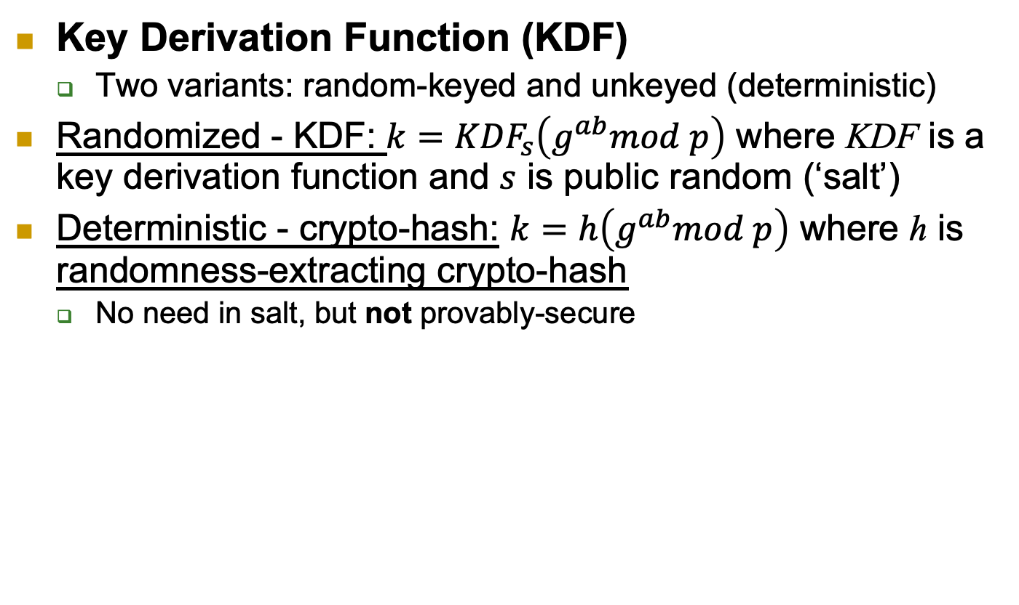
Using DH ‘securely’: CDH+KDF
Key Derivation Function (KDF)
Two variants: random-keyed and unkeyed (deterministic)
Randomized - KDF: $k={KDF}_{s}\left(g^{ab}mod p\right)$ where KDF is a key derivation function and $s$ is public random (‘salt’)
Deterministic - crypto-hash: $k=h\left(g^{ab}mod p\right)$ where h is randomness-extracting crypto-hash
No need in salt, but not provably-secure

Slide 43
Resilience to Key Exposure
43

Slide 44
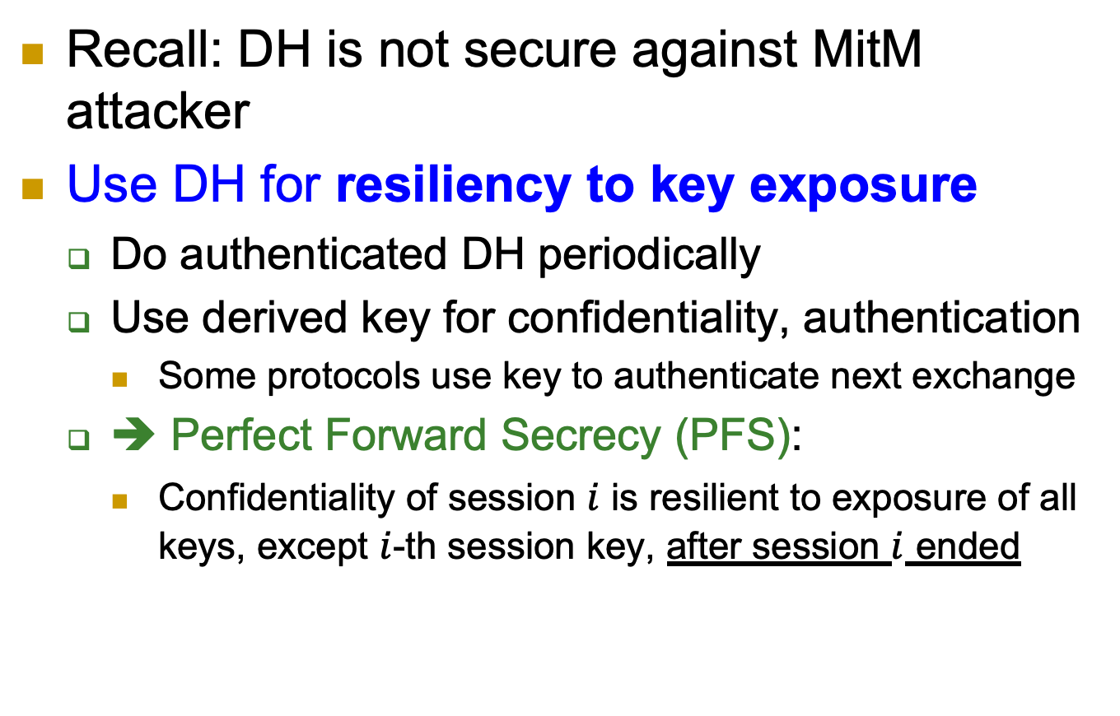
Authenticated DH
Recall: DH is not secure against MitM attacker
Use DH for resiliency to key exposure
Do authenticated DH periodically
Use derived key for confidentiality, authentication
Some protocols use key to authenticate next exchange
➔ Perfect Forward Secrecy (PFS):
Confidentiality of session $i$ is resilient to exposure of all keys, except $i$-th session key, after session $i$ ended

Slide 45
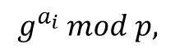
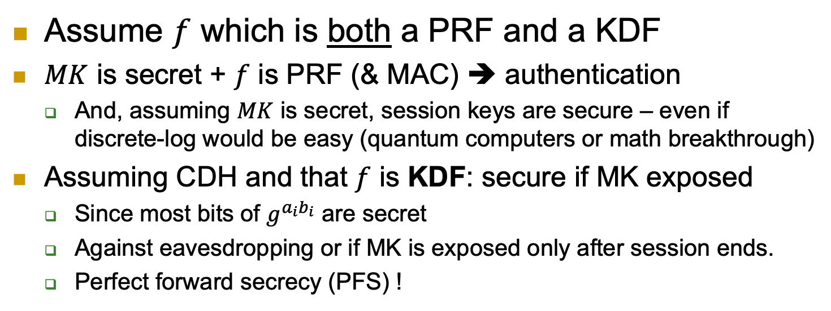
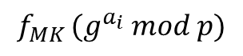
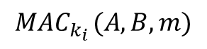
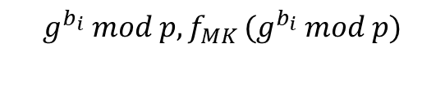
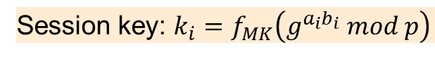
Authenticated DH: using KDF/PRF [TLS]
Assume $f$ which is both a PRF and a KDF
$MK$ is secret + $f$ is PRF (& MAC) ➔ authentication
And, assuming $MK$ is secret, session keys are secure – even if discrete-log would be easy (quantum computers or math breakthrough)
Assuming CDH and that $f$ is KDF: secure if MK exposed
Since most bits of $g^{a_{i}b_{i}}$ are secret
Against eavesdropping or if MK is exposed only after session ends.
Perfect forward secrecy (PFS) !
Alice
$$g^{a_{i}} mod p,$$
$$f_{MK} (g^{a_{i}} mod p)$$
Bob
$$g^{b_{i}} mod p, f_{MK} (g^{b_{i}} mod p)$$
Session key: $k_{i}=f_{MK}\left(g^{a_{i}b_{i}} mod p\right)$
$${MAC}_{k_{i}} (A,B,m)$$
Notes:
Assuming hash is a random function we could also simply use $k_{i}=h(g^{a_{i}b_{i}}) mod p$

Slide 46
Resilience to Key Exposure: Recover Security
The previous DH protocol does not achieve recover security, why?
Exposing ML makes all future session vulnerable to MitM (this adversary can authenticate any public key he wants to the other party).
There is another version, called Ratchet DH, that achieves perfect recover security.
Will not be covered in this class.
Notes:
46
(c) Amir Herzberg, http://AmirHerzberg.com, Bar Ilan University
11/13/11
`Perfect’ is not really the right term… but that’s the commonly used term.

Slide 47
Covered Material From the Textbook
Appendix A.2
Chapter 6:
Sections 6.1 (except 6.1.8.3),
Section 6.2 (6.2.1 and 6.2.3 are optional reading),
and Section 6.3 (except 6.3.2)

Slide 48

Thank You!

